Slide 1
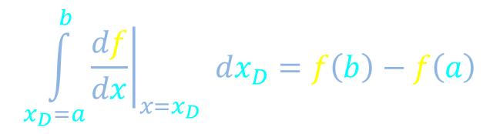


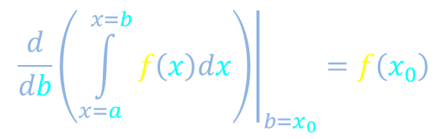
Integrals
$$\frac{dh}{dt}$$
Integrate
$$h\left(t\right)$$
Area under the curve
Fundamental theorem of calculus I
Change of variables
$${\left.\frac{d}{db}\left(\int_{x=a}^{x=b}{f\left(x\right)dx}\right)\right|}_{b=x_{0}}=f\left(x_{0}\right)$$
Fundamental theorem of calculus II
$$\int_{x_{D}=a}^{b}{{\left.\frac{df}{dx}\right|}_{x=x_{D}} dx_{D}}=f\left(b\right)−f\left(a\right)$$

Slide 2
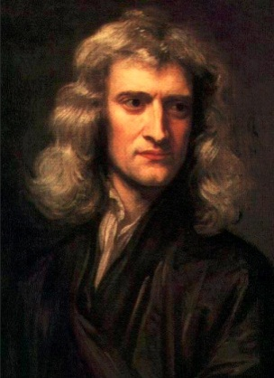
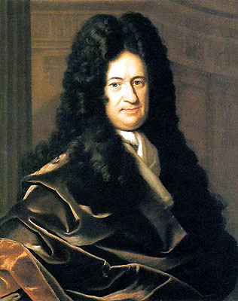




Area under the curve
$$f\left(x\right)$$
$$x$$
0
$$a$$
$$b$$

Slide 3



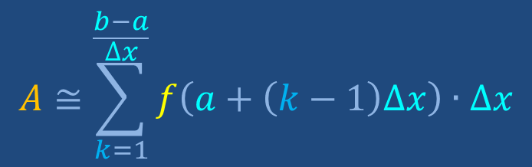





Area under the curve
$$A≅\sum_{k=1}^{\frac{b−a}{∆x}}{f\left(a+\left(k−1\right)∆x\right)∙∆x}$$
$$f\left(x\right)$$
$$∆A$$
$$f\left(a+∆x\right)$$
Verify that this sum makes sense. There are values of Δx that break this picture. What are they?
STOP
$${∆A}_{1}$$
$${∆A}_{2}$$
$${∆A}_{3}$$
$${∆A}_{4}$$
$$x$$
0
$$∆x$$
$$a$$
$$a+∆x$$
$$b$$

Slide 4



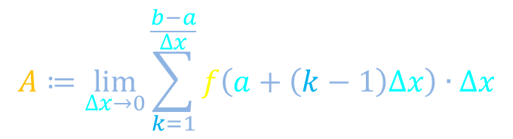
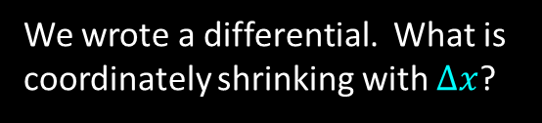

Area under the curve
$$A≅\sum_{k=1}^{\frac{b−a}{∆x}}{f\left(a+\left(k−1\right)∆x\right)∙∆x}$$
$$f\left(x\right)$$
$$f\left(x\right)$$
$$∆A$$
$$A≔\lim_{∆x→0}{\sum_{k=1}^{\frac{b−a}{∆x}}{f\left(a+\left(k−1\right)∆x\right)∙∆x}}$$
$$≔$$
$$A=\int_{x=a}^{x=b}{f\left(x\right)dx}$$
$$x$$
“Definite integral”
0
$$a$$
$$b$$
STOP
We wrote a differential. What is coordinately shrinking with $∆x$?
$$\frac{d?}{dx}=\lim_{∆x→0}{\frac{Δ?}{Δx}}$$

Slide 5
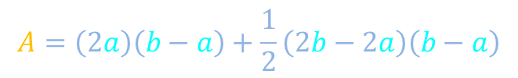



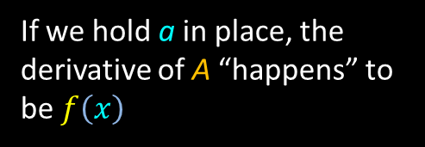








Example: Area under a line
$$f\left(x\right)=2x$$
$$A=\int_{x=a}^{x=b}{f\left(x\right)dx}$$
$$2b$$
$$f\left(x\right)$$
$$A=\left(2a\right)\left(b−a\right)+\frac{1}{2}\left(2b−2a\right)\left(b−a\right)$$
$$2b−2a$$
$$A=\left(a+b\right)\left(b−a\right)$$
$$A=b^{2}−a^{2}$$
$$2a$$
If we hold a in place, the derivative of A “happens” to be $f\left(x\right)$
STOP
$$x$$
$${\left.\frac{dA}{db}\right|}_{b=x}=2x$$
0
$$a$$
$$b$$
Differentiation “undoes” integration. Do you remember why?

Slide 6
Integrals
$$\frac{dh}{dt}$$
Integrate
$$h\left(t\right)$$
Area under the curve
Fundamental theorem of calculus I
Change of variables
$${\left.\frac{d}{db}\left(\int_{x=a}^{x=b}{f\left(x\right)dx}\right)\right|}_{b=x_{0}}=f\left(x_{0}\right)$$
Fundamental theorem of calculus II
$$\int_{x_{D}=a}^{b}{{\left.\frac{df}{dx}\right|}_{x=x_{D}} dx_{D}}=f\left(b\right)−f\left(a\right)$$

Slide 7





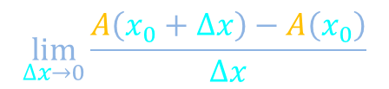



FToC: Differentiation “undoes” integration
$${\left.\frac{d}{db}\left(\int_{x=a}^{x=b}{f\left(x\right)dx}\right)\right|}_{b=x_{0}}=f\left(x_{0}\right)$$
$$A=\int_{x=a}^{x=b}{f\left(x\right)dx}$$
$$f\left(x\right)$$
Want
$$\lim_{∆x→0}{\frac{A\left(x_{0}+∆x\right)−A\left(x_{0}\right)}{∆x}}$$
$$A\left(x_{0}\right)=Area of$$
$$A\left(x_{0}+∆x\right)=Area of$$
$$A\left(x_{0}+∆x\right)−A\left(x_{0}\right)=Area of$$
$$x$$
0
$$a$$
$$x_{0}$$
$$x_{0}+∆x$$

Slide 8

FToC: Differentiation “undoes” integration
$${\left.\frac{d}{db}\left(\int_{x=a}^{x=b}{f\left(x\right)dx}\right)\right|}_{b=x_{0}}=f\left(x_{0}\right)$$
$$\lim_{∆x→0}{\frac{A\left(x_{0}+∆x\right)−A\left(x_{0}\right)}{∆x}}$$
Want
$$A\left(x_{0}+∆x\right)−A\left(x_{0}\right)=Area of$$
$$f\left(x\right)$$
$$x$$
0
$$a$$
$$x_{0}$$
$$x_{0}+∆x$$

Slide 9

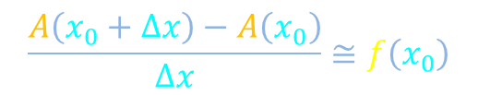






FToC: Differentiation “undoes” integration
$${\left.\frac{d}{db}\left(\int_{x=a}^{x=b}{f\left(x\right)dx}\right)\right|}_{b=x_{0}}=f\left(x_{0}\right)$$
$$\lim_{∆x→0}{\frac{A\left(x_{0}+∆x\right)−A\left(x_{0}\right)}{∆x}}$$
Want
$$A$$
$$A\left(x_{0}+∆x\right)−A\left(x_{0}\right)=Area of$$
$$f\left(x\right)$$
$$A\left(x_{0}+∆x\right)−A\left(x_{0}\right)≅Area of$$
$$f\left(x_{0}\right)$$
$$A\left(x_{0}+∆x\right)−A\left(x_{0}\right)≅f\left(x_{0}\right)∆x$$
$$\frac{A\left(x_{0}+∆x\right)−A\left(x_{0}\right)}{∆x}≅f\left(x_{0}\right)$$
$${\left.\frac{dA}{db}\right|}_{b=x_{0}}=f\left(x_{0}\right)$$
$$∆x$$
$$x$$
0
$$a$$
$$x_{0}$$
$$x_{0}+∆x$$

Slide 10

Integrals
$$\frac{dh}{dt}$$
Integrate
$$h\left(t\right)$$
Area under the curve
Fundamental theorem of calculus I
Change of variables
$${\left.\frac{d}{db}\left(\int_{x=a}^{x=b}{f\left(x\right)dx}\right)\right|}_{b=x_{0}}=f\left(x_{0}\right)$$
Fundamental theorem of calculus II
$$\int_{x_{D}=a}^{b}{{\left.\frac{df}{dx}\right|}_{x=x_{D}} dx_{D}}=f\left(b\right)−f\left(a\right)$$

Slide 11














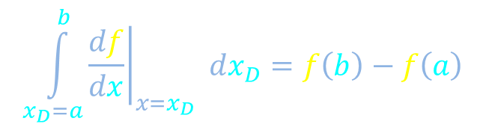
FToC: Integration “undoes” differentiation
$$f\left(x\right)$$
$$∆f≅{\left.\frac{df}{dx}\right|}_{x=x_{0}}∆x$$
$$∆x$$
$$x$$
0
$$\int_{x_{D}=a}^{b}{{\left.\frac{df}{dx}\right|}_{x=x_{D}} dx_{D}}=f\left(b\right)−f\left(a\right)$$
$$a$$
$$x_{0}$$
$$b$$
$${\left.\frac{df}{dx}\right|}_{x=x_{D}}$$
$$∆A={\left.\frac{df}{dx}\right|}_{x=x_{0}}∆x$$
$${\left.\frac{df}{dx}\right|}_{x=x_{0}}$$
$$x_{D}$$
0
$$x_{0}$$
$$∆x$$
$$a$$
$$b$$

Slide 12




FToC: Integration “undoes” differentiation
$$f\left(x\right)$$
$$f\left(b\right)$$
$$f\left(a\right)$$
$$x$$
0
$$\int_{x_{D}=a}^{b}{{\left.\frac{df}{dx}\right|}_{x=x_{D}} dx_{D}}=f\left(b\right)−f\left(a\right)$$
$$a$$
$$x_{0}$$
$$b$$
$${\left.\frac{df}{dx}\right|}_{x=x_{D}}$$
$$x_{D}$$
0
$$a$$
$$x_{0}$$
$$b$$

Slide 13
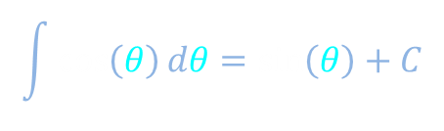



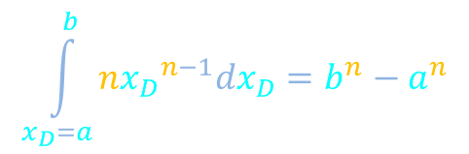


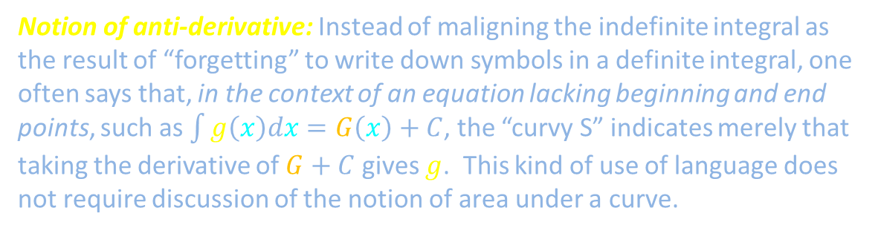


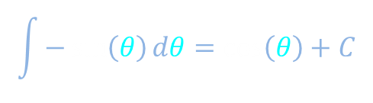
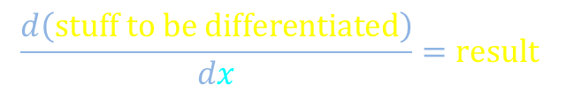
Example integral table
$$\int_{x_{D}=a}^{b}{{\left.\frac{df}{dx}\right|}_{x=x_{D}} dx_{D}}=f\left(b\right)−f\left(a\right)$$
$$f\left(x\right)=x^{n}$$
$$\int{nx^{n−1}dx}=x^{n}+C$$
$${\left.\frac{df}{dx}\right|}_{x=x_{D}}=n{x_{D}}^{n−1}$$
$$\int{\cos\left(θ\right)dθ}=\sin\left(θ\right)+C$$
$$x$$
$$\int_{x_{D}=a}^{b}{n{x_{D}}^{n−1}dx_{D}}=b^{n}−a^{n}$$
$$\int{−\sin\left(θ\right)dθ}=\cos\left(θ\right)+C$$
$$x$$
$$+ C$$
Generic differentiation rule
Notion of anti-derivative: Instead of maligning the indefinite integral as the result of “forgetting” to write down symbols in a definite integral, one often says that, in the context of an equation lacking beginning and end points, such as $\int{g\left(x\right)dx}=G\left(x\right)+C$, the “curvy S” indicates merely that taking the derivative of $G+C$ gives $g$. This kind of use of language does not require discussion of the notion of area under a curve.
STOP
$$\frac{d\left(stuff to be differentiated\right)}{dx}=result$$

Slide 14
Integrals
$$\frac{dh}{dt}$$
Integrate
$$h\left(t\right)$$
Area under the curve
Fundamental theorem of calculus I
Change of variables
$${\left.\frac{d}{db}\left(\int_{x=a}^{x=b}{f\left(x\right)dx}\right)\right|}_{b=x_{0}}=f\left(x_{0}\right)$$
Fundamental theorem of calculus II
$$\int_{x_{D}=a}^{b}{{\left.\frac{df}{dx}\right|}_{x=x_{D}} dx_{D}}=f\left(b\right)−f\left(a\right)$$

Slide 15

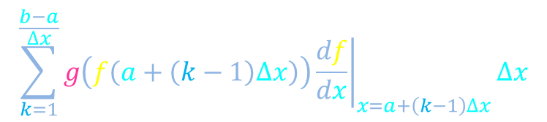

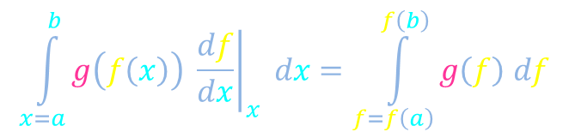












Change of variables
$$\int_{x=a}^{b}{g\left(f\left(x\right)\right) {\left.\frac{df}{dx}\right|}_{x} dx}=\int_{f=f\left(a\right)}^{f\left(b\right)}{g\left(f\right) df}$$
$$f$$
$$f\left(x\right)$$
$$f\left(b\right)$$
$$g\left(f\left(x\right)\right)$$
$$∆f$$
$$∆f≅{\left.\frac{df}{dx}\right|}_{x=x_{0}}∆x$$
$$∆x$$
$$≅$$
$$g\left(f\left(x_{0}\right)\right)$$
$$f\left(a\right)$$
$$\sum_{k=1}^{\frac{b−a}{∆x}}{g\left(f\left(a+\left(k−1\right)∆x\right)\right){\left.\frac{df}{dx}\right|}_{x=a+\left(k−1\right)∆x}∆x}$$
$$x$$
0
$$a$$
$$x_{0}$$
$$b$$
$$g$$

Slide 16


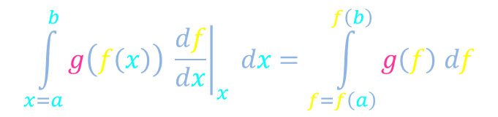

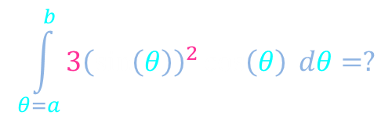
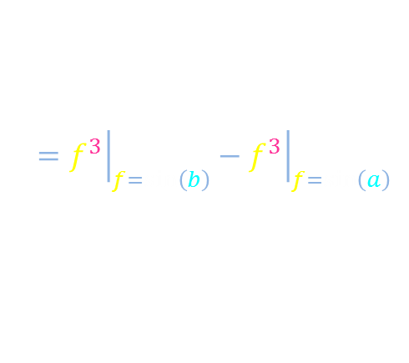




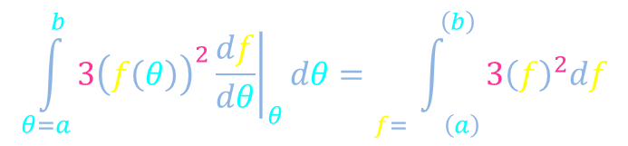



Change of variables example: Trigonometric functions
$$f$$
$$f\left(x\right)$$
$$\int_{x=a}^{b}{g\left(f\left(x\right)\right) {\left.\frac{df}{dx}\right|}_{x} dx}=\int_{f=f\left(a\right)}^{f\left(b\right)}{g\left(f\right) df}$$
$$g\left(f\left(x\right)\right)$$
$$∆f$$
$$\int_{θ=a}^{b}{3{\left(\sin\left(θ\right)\right)}^{2}\cos\left(θ\right) dθ}=?$$
$$x$$
0
$$a$$
$$b$$
Choose to identify
$$g$$
$${\left.\frac{df}{dθ}\right|}_{θ}=\cos\left(θ\right)$$
$$f\left(θ\right)=\sin\left(θ\right)$$
$$\int_{θ=a}^{b}{3{\left(f\left(θ\right)\right)}^{2}{\left.\frac{df}{dθ}\right|}_{θ}dθ}=\int_{f=sin\left(a\right)}^{sin\left(b\right)}{3{\left(f\right)}^{2}df}$$
$$={\left.f^{3}\right|}_{f=sin\left(b\right)}−{\left.f^{3}\right|}_{f=sin\left(a\right)}$$
Find in integration table:
$$\int{3f^{2}df}=f^{3}+C$$
$$={\left(sin\left(b\right)\right)}^{3}−{\left(sin\left(a\right)\right)}^{3}$$

Slide 17
Integrals
$$\frac{dh}{dt}$$
Integrate
$$h\left(t\right)$$
Area under the curve
Fundamental theorem of calculus I
Change of variables
$${\left.\frac{d}{db}\left(\int_{x=a}^{x=b}{f\left(x\right)dx}\right)\right|}_{b=x_{0}}=f\left(x_{0}\right)$$
Fundamental theorem of calculus II
$$\int_{x_{D}=a}^{b}{{\left.\frac{df}{dx}\right|}_{x=x_{D}} dx_{D}}=f\left(b\right)−f\left(a\right)$$

Slide 18


Integrals
Integration: Figuring out accumulated change from rates of change
Accumulated change: How much distance will we travel in an hour?
Rates of change: How fast will we drive at different times?
Area under the curve
Fundamental theorem of calculus I
Change of variables
$${\left.\frac{d}{db}\left(\int_{x=a}^{x=b}{f\left(x\right)dx}\right)\right|}_{b=x_{0}}=f\left(x_{0}\right)$$
Fundamental theorem of calculus II
$$\int_{x_{D}=a}^{b}{{\left.\frac{df}{dx}\right|}_{x=x_{D}} dx_{D}}=f\left(b\right)−f\left(a\right)$$

